Slide 1
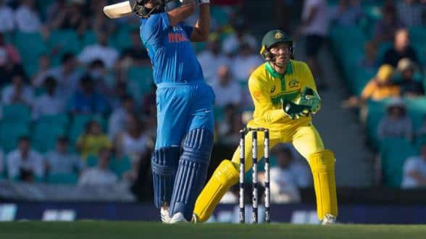
CRICTRS: EMBEDDINGS BASED STATISTICAL AND SEMI SUPERVISED CRICKET TEAM RECOMMENDATION SYSTEM
DTMN - 2020
Prazwal Chhabra, Rizwan Ali, Dr. Vikram Pudi
International Institute of Information Technology, Hyderabad, India
prazwal.chhabra@students.iiit.ac.in, rizwan.ali@students.iiit.ac.in, vikram@iiit.ac.in

Slide 2
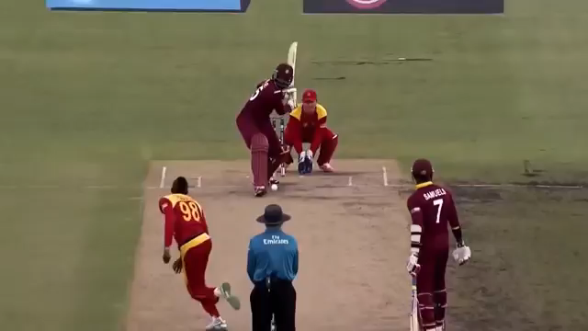
What is cricket ? Get to know the sport.
Credits : International Cricket Council ( www.icc.com )

Slide 3
Abstract
Team Recommendation has always been a challenging aspect in team sports. Such recommendation systems aim to recommend a group of players, best suited against the opposition team. In this paper, we propose a semi-supervised statistical approach, to build a team recommendation system for cricket by modelling players into embeddings. To build these embeddings, we design a qualitative and quantitative rating system which considers the strength of opposition also for evaluating player’s performance. The embeddings obtained, describes the strengths and weaknesses of the players based on their past performances. We also embark on a critical aspect of team composition, which includes the number of batsmen, bowlers and all-rounders in the team. The team composition changes over time, depending on different factors like weather, pitch conditions, ground dimensions, etc., which are tough to predict in statistical settings, so we take this input from the user and use the player embeddings to decide the best possible team combination with the given team composition.

Slide 4
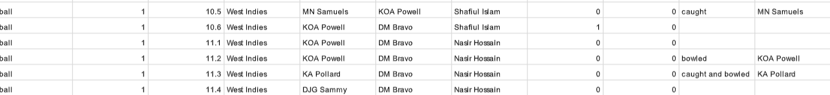
Dataset
Cricsheet.org [ Cricsheet, 2019. [Online], Available: https://cricsheet.org/downloads/odis.zip ] provides an open source dataset which consists of ball-by-ball proceedings of 1500+ international ODI matches from 2003-present.
Fig 1 : A snapshot of the dataset

Slide 5
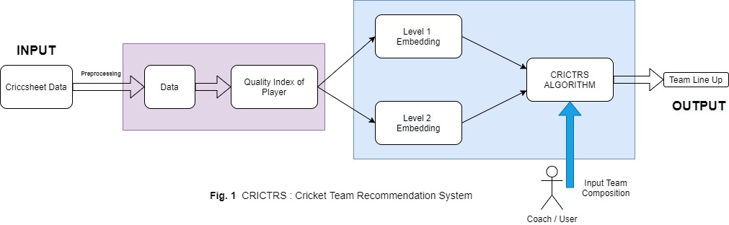
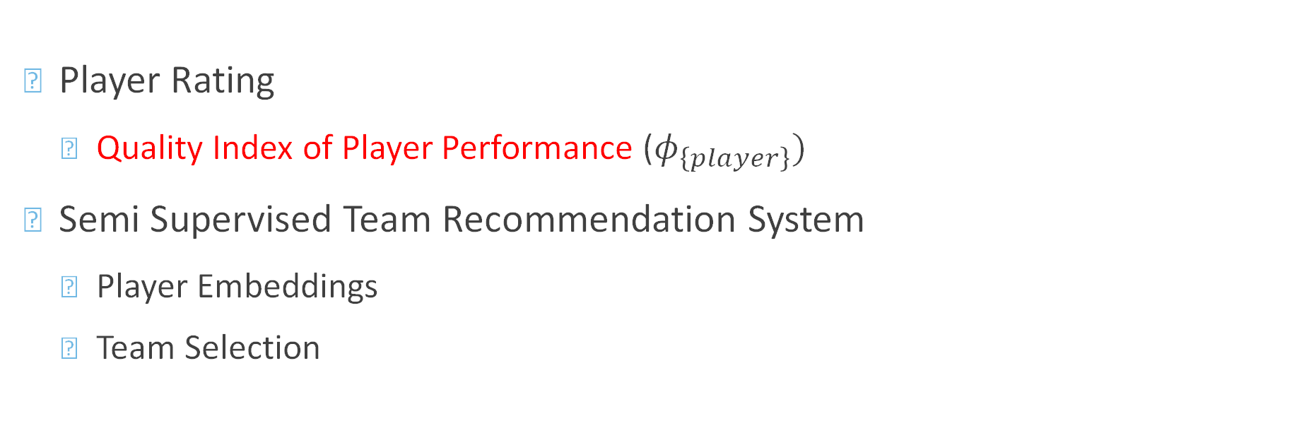
Components
Player Rating
Quality Index of Player Performance ($φ_{\left\{player\right\}})$
Semi Supervised Team Recommendation System
Player Embeddings
Team Selection

Slide 6

Quality Index Of Player Performance ($φ_{\left\{player\right\}}$)
Modelling the match
A cricket match is a collection of complex events. For statistical study of a cricket match, we built upon the idea proposed by [1] and model the match as a collection Bernoulli events.
Each delivery of the ODI match (50 overs ( 1 over = 6 balls ) = 300 ball) is considered as a Bernoulli trial with two possible outcomes, ‘r’ runs scored per ball or a wicket.
‘r’ = average runs scored in a delivery
number of wicket per innings <= 10
To evaluate a player’s rating, create a team with 11 replicas of same player, and evaluate ‘r’ by using historical data and simulating a match as shown next.
[1] A. Ramalingam, “Bernoulli runs using ‘book cricket’ to evaluate cricketers,” Reson, vol. 17, no. 5, pp. 441–453, May 2012, doi: 10.1007/s12045-012-0047-2.

Slide 7
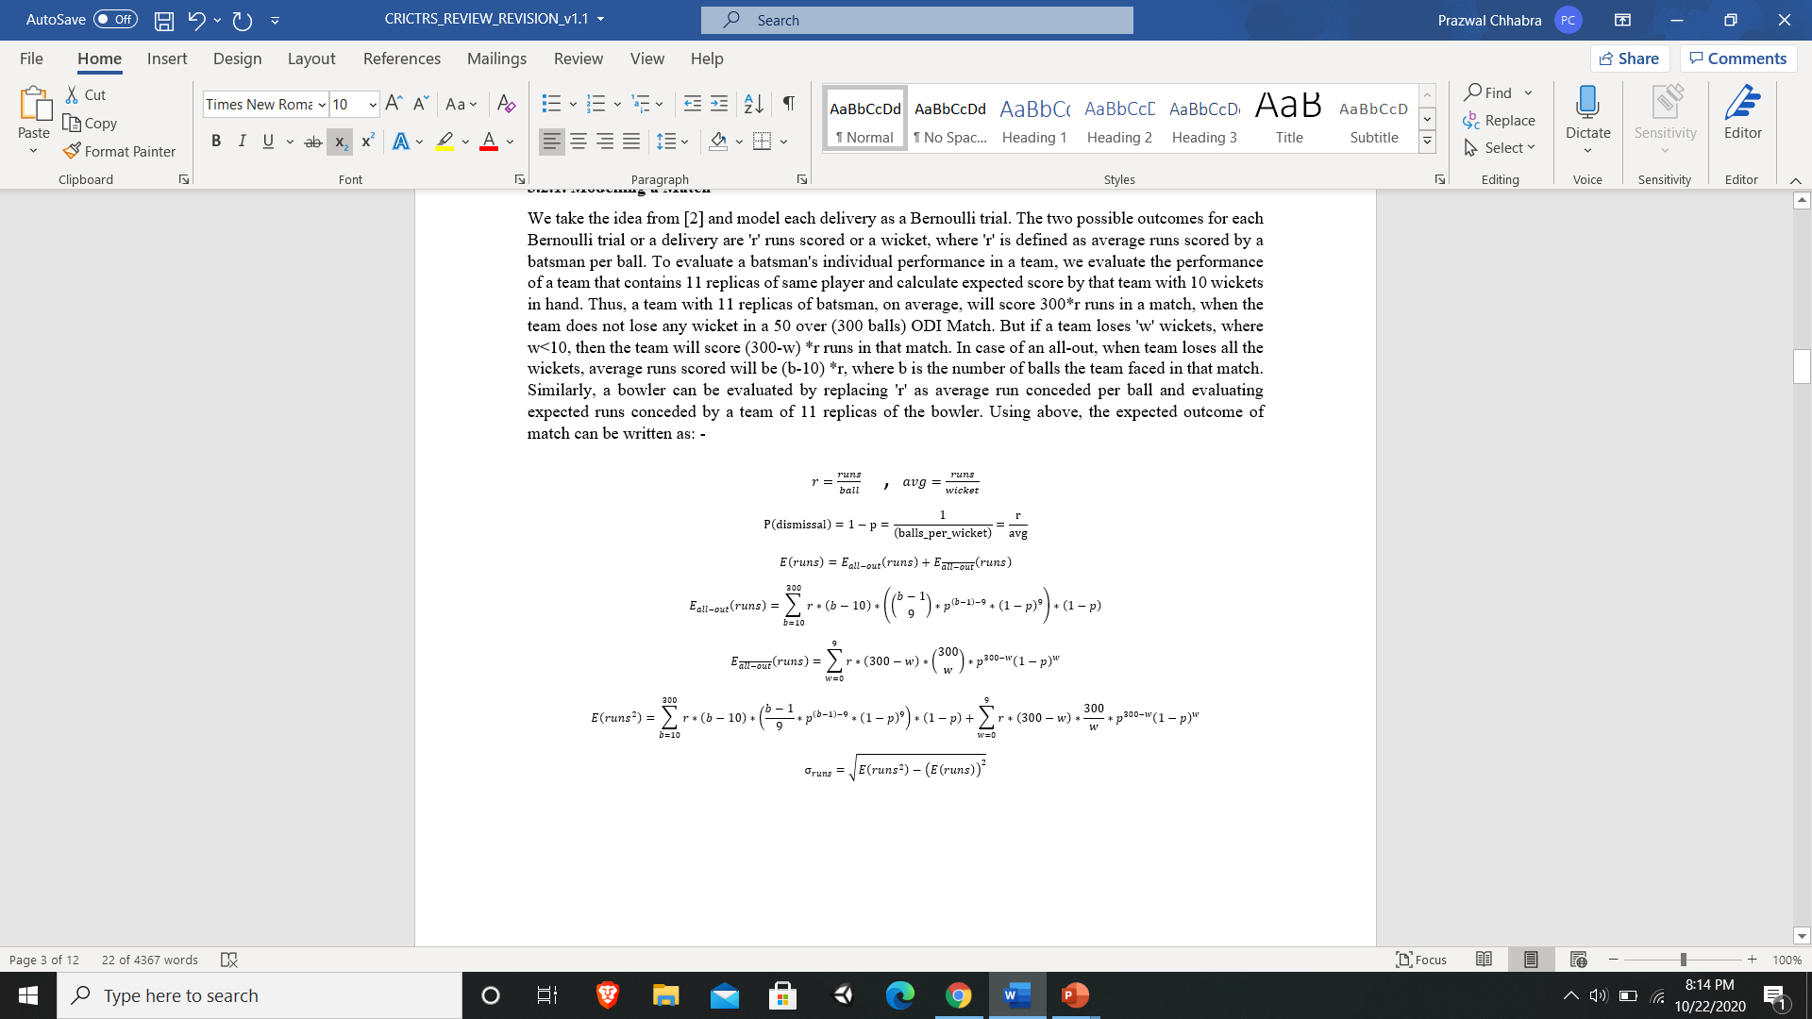
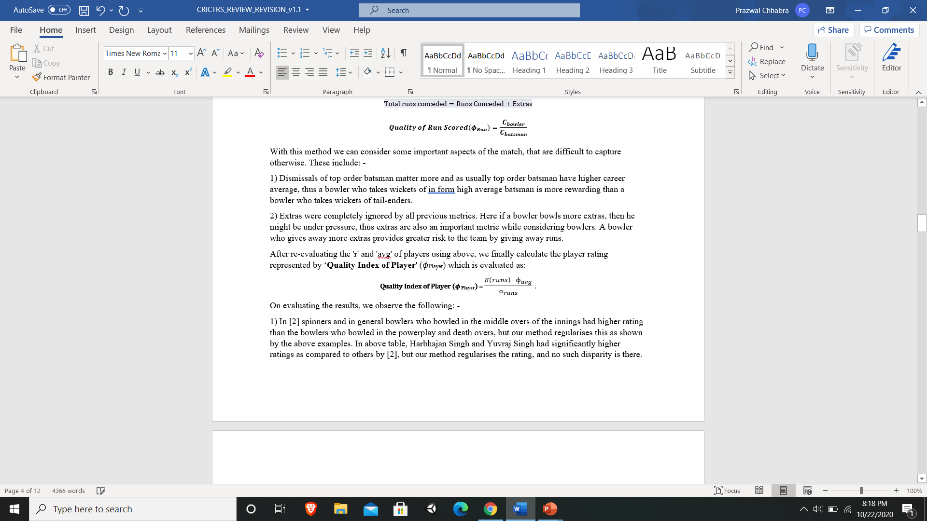
Quality Index Of Player Performance ($φ_{\left\{player\right\}}$)

Slide 8
Quality Index Of Player Performance ($φ_{\left\{player\right\}}$)
Most of the existing player rating algorithms in literature are purely quantitative and use only the quantitative metrics to evaluate player performance, which can be misleading at times.
In 𝜙_{𝑝𝑙𝑎𝑦𝑒𝑟}, we add an important aspect to the rating which is often ignored by player rating algorithms, which is by considering the quality of opposition while evaluating the 𝜙_{𝑝𝑙𝑎𝑦𝑒𝑟}.
Image Credits : https://theconversation.com/what-data-tells-us-about-the-best-cricket-players-87000

Slide 9
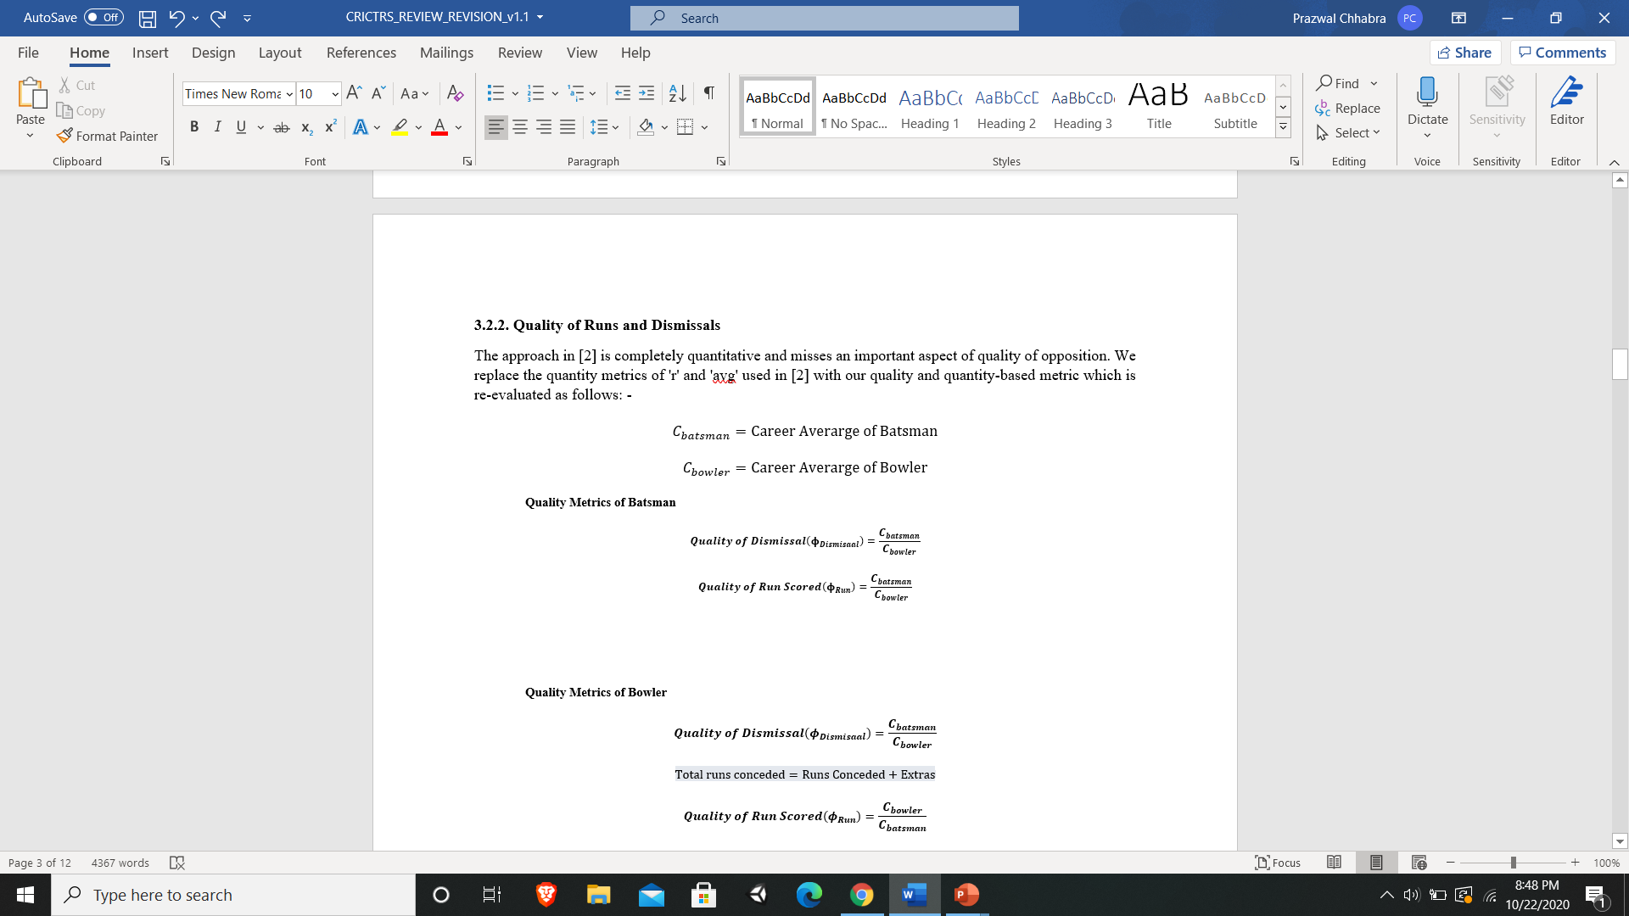
Quality Index Of Player Performance ($φ_{\left\{player\right\}}$)
We modify the runs scored and wickets taken by multiplying the quality metrics with them. The quality metrics were evaluated as shown below:-

Slide 10
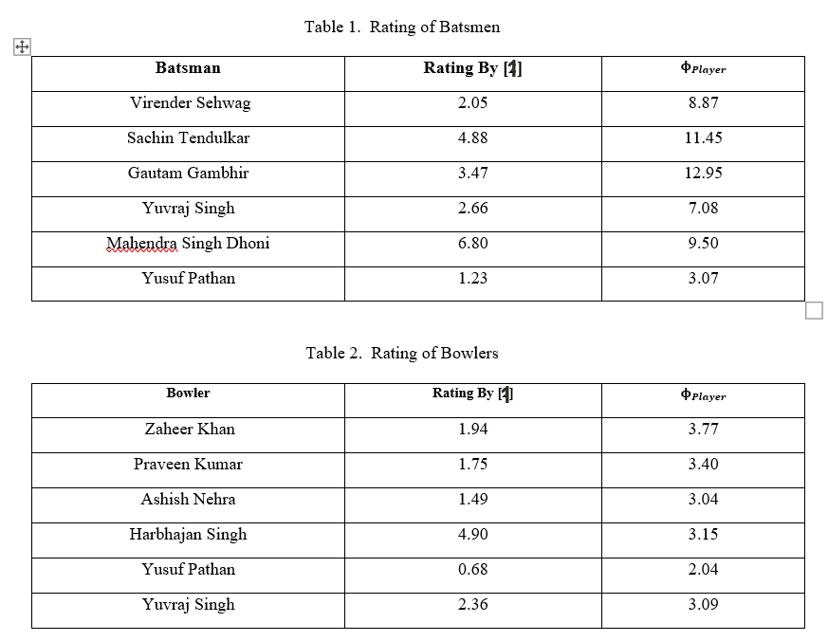
Quality Index Of Player Performance ($φ_{\left\{player\right\}}$)
Major improvements:-
No significant difference in ratings for different bowler types.
Extras also considered.
Considering quality aspect of performance changes player ratings significantly.

Slide 11
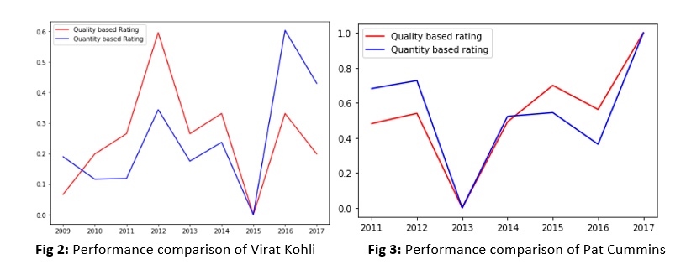
Quality Index Of Player Performance ($φ_{\left\{player\right\}}$)

Slide 12
Semi Supervised Team Recommendation System
Semi Supervised Team Recommendation System
Player Embeddings
Team Selection

Slide 13
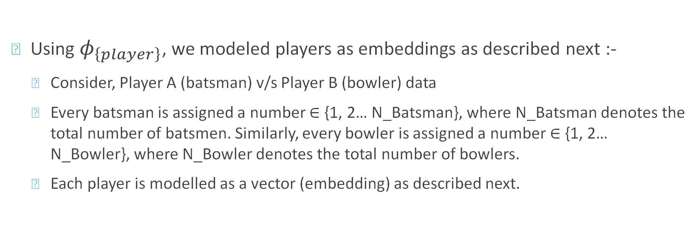
Player Embeddings
Using $φ_{\left\{player\right\}}$, we modeled players as embeddings as described next :-
Consider, Player A (batsman) v/s Player B (bowler) data
Every batsman is assigned a number ∈ {1, 2… N_Batsman}, where N_Batsman denotes the total number of batsmen. Similarly, every bowler is assigned a number ∈ {1, 2… N_Bowler}, where N_Bowler denotes the total number of bowlers.
Each player is modelled as a vector (embedding) as described next.

Slide 14
Player Embeddings
Level 1 Embeddings :
For a batsman, the Level 1 embedding is a vector, where index 'i' of the embedding gives 𝜙_{batsman} against the bowler assigned the number i. Similarly, for a bowler, the Level 1 embedding is also a vector, where index 'i' of the embedding gives 𝜙_{bowler} against the batsman assigned the number i. The 𝜙_{Player} at each index is calculated using batsman versus bowler data corresponding to that index, extracted from different matches in the dataset. Also, all those indices in the embeddings are set to 0, for which versus data is not available, as those players did not face each other.

Slide 15
Player Embeddings
Level 2 Embeddings :
The Level 2 embeddings are derived from Level 1 embeddings. For every batsman we compare 𝜙_{Player} over his career against all the bowlers with the values at every index in the level 1 embedding representing batsman's performance against those bowlers. If the players have faced each other and there is a significant negative deviation in the performance of the batsman i.e. there is a drop in 𝜙_{Player} for batsman, then the index is set to 0, otherwise it's set to 1. Similar process is followed for the bowlers and embeddings are constructed for bowlers also by comparing their performance against different batsmen with their overall performance. The level 2 embeddings, in a way, represent a batsman in terms of the bowlers he dominates, and the bowlers in terms of the batsmen they dominate.

Slide 16
Player Embeddings
Level 1 Embeddings
 | Bowler 1 | Bowler 2 | Bowler 3 | Bowler 4
Batsman 1 | 4.3 | 0 | 6.7 | 0.4
Batsman 2 | 0 | 13.8 | 19.3 | 9.5
Batsman 3 | 49.6 | 40.7 | 39.1 | 3.0
Batsman 4 | 0 | 0 | 12.3 | 0

Slide 17
Player Embeddings
Level 2 Embeddings
 | Bowler 1 | Bowler 2 | Bowler 3 | Bowler 4
Batsman 1 | 1 | 0 | 1 | 0
Batsman 2 | 0 | 1 | 1 | 1
Batsman 3 | 1 | 1 | 1 | 0
Batsman 4 | 0 | 0 | 1 | 0

Slide 18
Player Embeddings
Level 1 Embeddings v/s Level 2 Embeddings
Batsman 1 | 4.3 | 0 | 6.7 | 0.4
Batsman 1 | 1 | 0 | 1 | 0

Slide 19
Semi Supervised Team Recommendation System
Semi Supervised Team Recommendation System
Player Embeddings
Team Selection

Slide 20
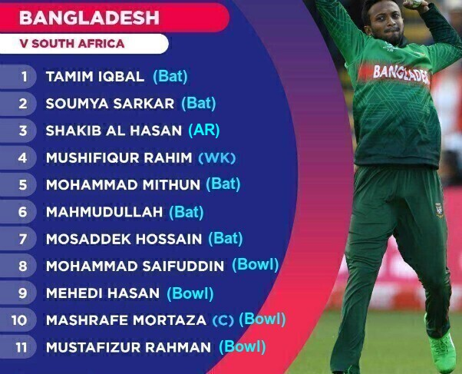
Team Composition
Team Composition means the number of wicket-keepers, batsmen, bowlers and all-rounders in a team of 11 players.
With rules in place like, a player can bowl a maximum of 10 overs in a 50 over game. We must have, Number of Bowlers + Number of All-Rounders >= 5. Also there must be 1 WK in team, to stay behind the batsman’s stump.
The team composition changes over time, depending on different factors which are tough to predict in a statistical setting, so we take this input from the user and use the player embeddings to decide the best possible team combination with the given team composition.
Bangladesh Team against South Africa with their roles (www.cricinfo.com)

Slide 21
CONSTRAINTS ON THE SOLUTION
We'll return a collection of (Player,Role)
Role can be Batsman, Bowler, Wicket-Keeper or All-Rounder
ODI Format being considered for cricket
At least 11 players in the collection
At least 5 Bowlers and All Rounders
At least 1 Wicket-Keeper

Slide 22
ALGORITHM
Proposed Solution should satisfy the Constraints
Selecting Wicket-Keeper first
Selecting Batsmen and Bowlers after this
The opposing set of players change with the group of players for selection
Batsmen and Wicket-Keepers have Bowlers as the Opposition
Bowlers have Batsmen as the Opposition
The opposing players can be represented as a Bipartite Graph

Slide 23
ALGORITHM
Using Level 2 Embeddings, list out players across all countries weak against a particular player
This generates opposition against which the particular player is strong
Do this for all players
Substitute players with less record of played matches with closest similar player
Collaborative Filtering
Bipartite Graph Representation

Slide 24
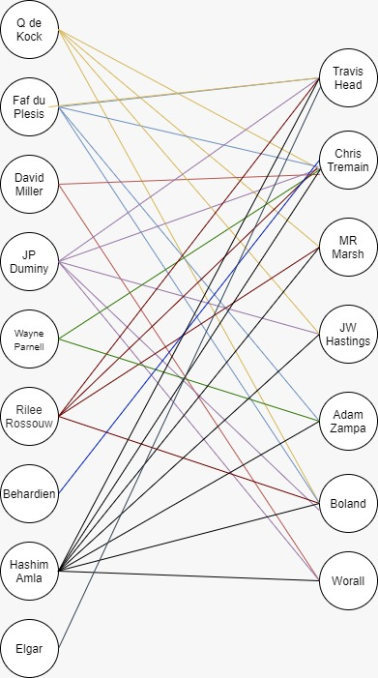
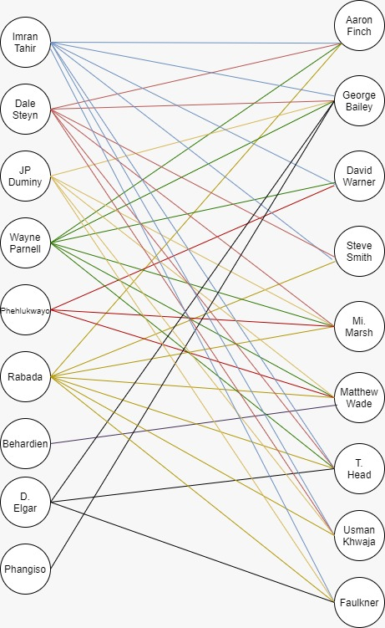
Bipartite graph representation

Slide 25
ORDERING AND SELECTING PLAYERS FROM BIPARTITE GRAPHS
Edge Weight is Quality Index of Player (Φ_{Player}) from Level 1 Embeddings
Define δ = Mean of Edge Weights / Standard Deviation of Edge Weights
High Variance player reduces stability of the combination
Sort in decreasing order of δ and make selection
Select Wicket-Keepers
Pick batsman (simultaneously mark All-Rounders)
Pick bowlers (simultaneously mark All-Rounders)

Slide 26
References
[1] A. Ramalingam, “Bernoulli runs using ‘book cricket’ to evaluate cricketers,” Reson, vol. 17, no. 5, pp. 441–453, May 2012, doi: 10.1007/s12045-012-0047-2.
[2] Video Introducing the basics of What is Cricket? https://www.icc-cricket.com/about/development/what-is-cricket (accessed July 24, 2020).
[3] MG Jhawar, and Vikram Pudi, "Honest Mirror: Quantitative Assessment of Player Performance in an ODI Cricket Match." in MLSA@ PKDD/ECML, 2017, pp. 62-72. Available: http://ceur-ws.org/Vol-1971/paper-08.pdf
[4] S. Akhtar, P. Scarf, and Z. Rasool, “Rating players in test match cricket,” Journal of the Operational Research Society, vol. 66, no. 4, pp. 684–695, Apr. 2015, doi: 10.1057/jors.2014.30.
[5] Margaret I. Johnston, Stephen R. Clarke, and David H. Noble. “Assessing player performance in one-day cricket using dynamic programming.” 1993.
[6] A. Kimber, “A Graphical Display for Comparing Bowlers in Cricket,” Teaching Statistics, vol. 15, no. 3, pp. 84–86, Sep. 1993, doi: 10.1111/j.1467-9639.1993.tb00664.x.

Slide 27
References
[7] Q. Zhou, L. Li, N. Cao, N. Buchler, and H. Tong, “E xtra,” presented at the RecSys ’18: Twelfth ACM Conference on Recommender Systems, Sep. 2018, doi: 10.1145/3240323.3241610.
[8] L. Li, H. Tong, N. Cao, K. Ehrlich, Y.-R. Lin, and N. Buchler, “Replacing the Irreplaceable,” presented at the the 24th International Conference, 2015, doi: 10.1145/2736277.2741132.
[9] Prakash, C. Deep, C. Patvardhan, and C. Vasantha Lakshmi. "AI Methodology for Automated Selection of Playing XI in IPL Cricket.", 2017. Available: http://www.ijetsr.com/images/short_pdf/1497897339_6-cdac191_etsr.pdf
[10] S. B. Jayanth, A. Anthony, G. Abhilasha, N. Shaik, and G. Srinivasa, “A team recommendation system and outcome prediction for the game of cricket,” JSA, vol. 4, no. 4, pp. 263–273, Nov. 2018, doi: 10.3233/JSA-170196.
[11] F. Ahmed, A. Jindal, and K. Deb, “Cricket Team Selection Using Evolutionary Multi-objective Optimization,” in Swarm, Evolutionary, and Memetic Computing, Springer Berlin Heidelberg, 2011, pp. 71–78.
[12] Cricsheet, 2019. [Online], Available: https://cricsheet.org/downloads/odis.zip.

Slide 28
References
[13] ESPNcricinfo. https://www.espncricinfo.com/ (accessed June 1, 2020).
[14] O. Alkan, E. M. Daly, and I. Vejsbjerg, “Opportunity Team Builder for Sales Teams,” presented at the 23rd International Conference, 2018, doi: 10.1145/3172944.3172968.
[15] Y. Koren and R. Bell, “Advances in Collaborative Filtering,” in Recommender Systems Handbook, Springer US, 2010, pp. 145–186.
[16] ICC Test-Match-Playing-Conditions. https://icc-static-files.s3.amazonaws.com/ICC/document/2019/09/02/9182955c-04a4-4fa0-a2b6-f5908f02a51d/ICC-Test-Match-Playing-Conditions-Final-1-September-2019.pdf
[17] ICC guidelines regarding ‘like-for-like' replacement. https://www.cricket.com.au/news/concussion-substitutes-like-for-like-replacement-icc-test-championship-ashes-geoff-allardice/2019-07-30
[18] Wikipedia Contributors.” Value over replacement player.” Wikipedia.com https://en.wikipedia.org/wiki/Value_over_replacement_player (accessed June 1, 2020).

